Slide 1
9 Databases
SQL

Slide 2
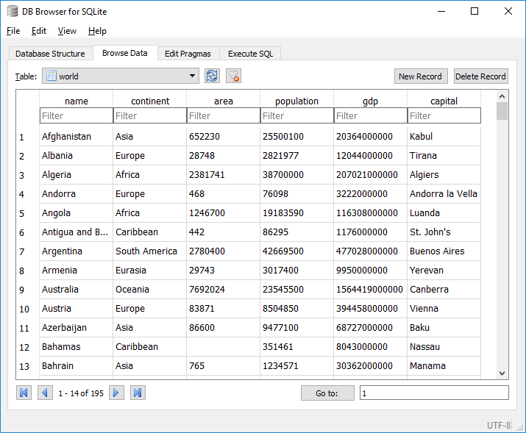
SQL: Structured Query Language
Information in a database is stored in records. Each record can contain a number of fields.

Slide 3
SQL: Structured Query Language
Information in a database is stored in records. Each record can contain a number of fields.
We can manipulate the data in these fields using a programming language called Structured Query Language (SQL).

Slide 4
SQL: Structured Query Language
Common SQL commands
SELECT
CREATE
ALTER
UPDATE
INSERT
DELETE
Common SQL commands
SELECT
CREATE
ALTER
UPDATE
INSERT
DELETE
Structured Query Language (SQL) statements supports a wide range of commands for manipulating a database.
The one you need to familiar with for the IGCSE exam is the SELECT statement.

Slide 5
SQL: Structured Query Language
Structured Query Language (SQL) statements follow a strict format.
The format for the SELECT statement is as follows:
SELECT…
FROM…
WHERE…
ORDER BY…
List the field(s) you want the SELECT query to display.
List the table(s) the data will come from.
List the search criteria.
Optional criteria to sort the data in ascending (ASC) or descending (DSC) order.

Slide 6
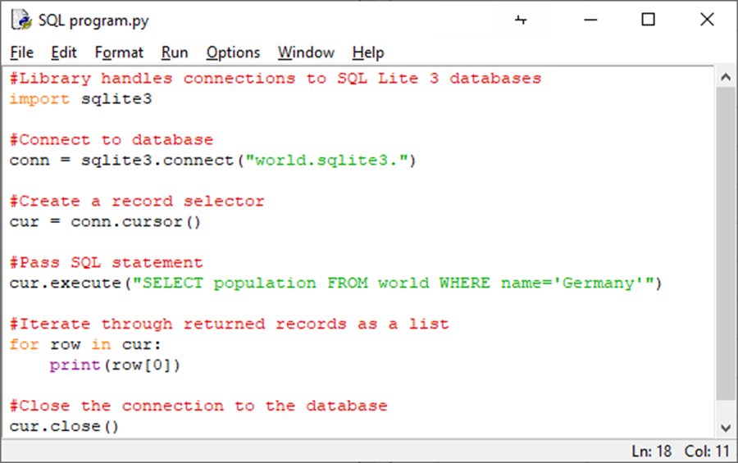
SQL: Structured Query Language
Here is a simple Python program that opens a connection to a database and finds records within it.
Most of the code in this program is beyond the IGCSE syllabus, so you don’t need to worry about it at this stage.

Slide 7
SQL: Structured Query Language
The part of the program you do need to know about is highlighted here.
This is where we can issue SQL commands to the database for the purpose of finding and outputting data.
SELECT population
FROM world
WHERE name = “Germany”

Slide 8
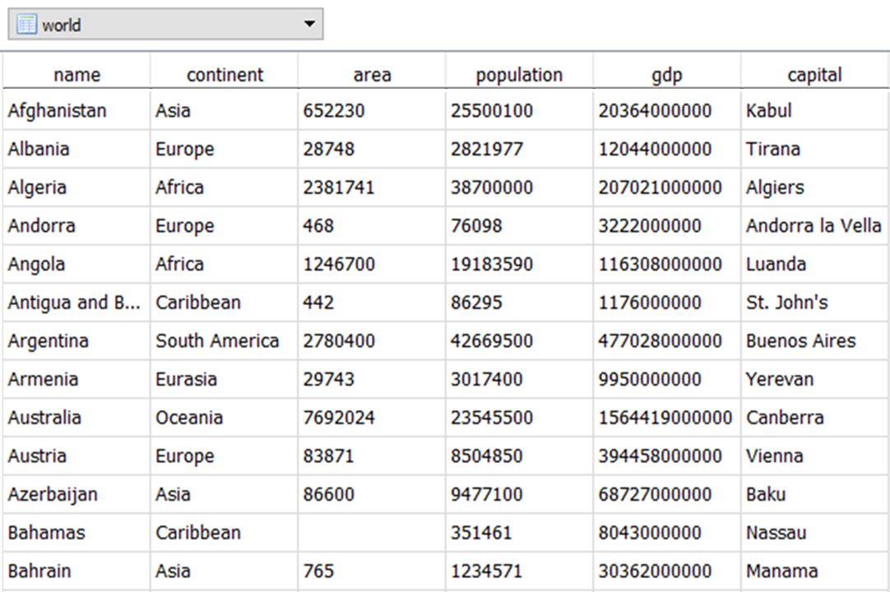
SQL: Structured Query Language
SELECT population
FROM world
WHERE name = “Albania”
Output from this SQL query:
2821977

Slide 9
SQL: Structured Query Language
SELECT name, continent, area, population, gdp, capital
FROM world
WHERE name = “Algeria”
Output from this SQL query:
Algeria,Africa,238174,38700000,207021000000,Algiers

Slide 10
SQL: Structured Query Language
SELECT name, continent, area, population, gdp, capital
FROM world
WHERE name LIKE “A%”
AND population > 10000000
ORDER BY name ASC
Output from this SQL query:
Afghanistan,Asia,652230,25500110,20364000000,Kabul
Algeria,Africa,238174,38700000,207021000000,Algiers
Angola,Africa,1246700,19183590,116308000000,Luanda
Argentina,South America,2780400,42669500,477028000000,Buenos Aires
Australia,Oceania,7692024,2354550,1564419000000,Canberra

Slide 11
SQL: Structured Query Language
SELECT COUNT(*)
FROM world
WHERE continent = “Asia”
Output from this SQL query:
3

Slide 12
SQL: Structured Query Language
SELECT SUM(population)
FROM world
WHERE continent = “Europe”
Output from this SQL query:
11402655

Slide 13

SQL: Structured Query Language
SQL is used to create, delete, modify and manipulate records in a database. Basic commands include:
SELECT which fields to be returned.
FROM which table – databases can have more than one table, each with their own unique name.
WHERE records meet a condition.
LIKE can be used as a wildcard.
ORDER BY: Choose how the data is organised when it is retrieved (e.g., ORDER BY name).
ORDER BY <field> ASC: Order by the selected field in ascending order.
ORDER BY <field> DESC: Order by the selected field in descending order.
SELECT SUM <field>: Specifies fields for calculation – should be integer or real.
SELECT COUNT <field>: Counts fields that meet the specified criteria.

Slide 14


